Slide 1
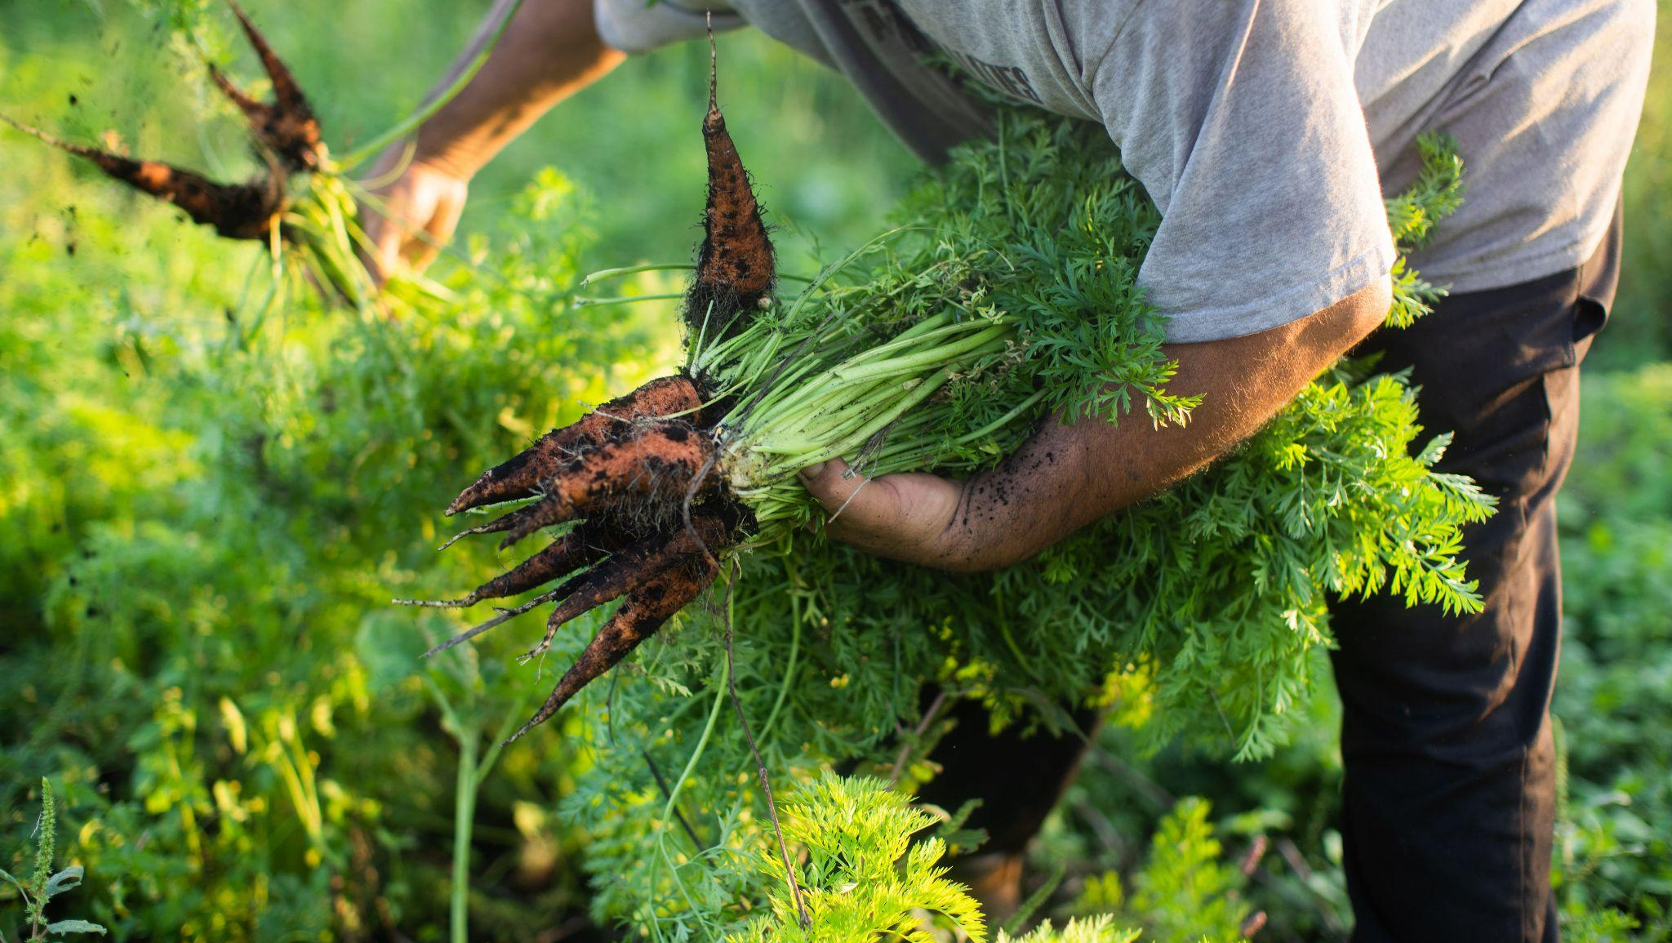
Food Sovereignty Fund
investing in shared abundance
NYS Food Summit, June 2024

Slide 2
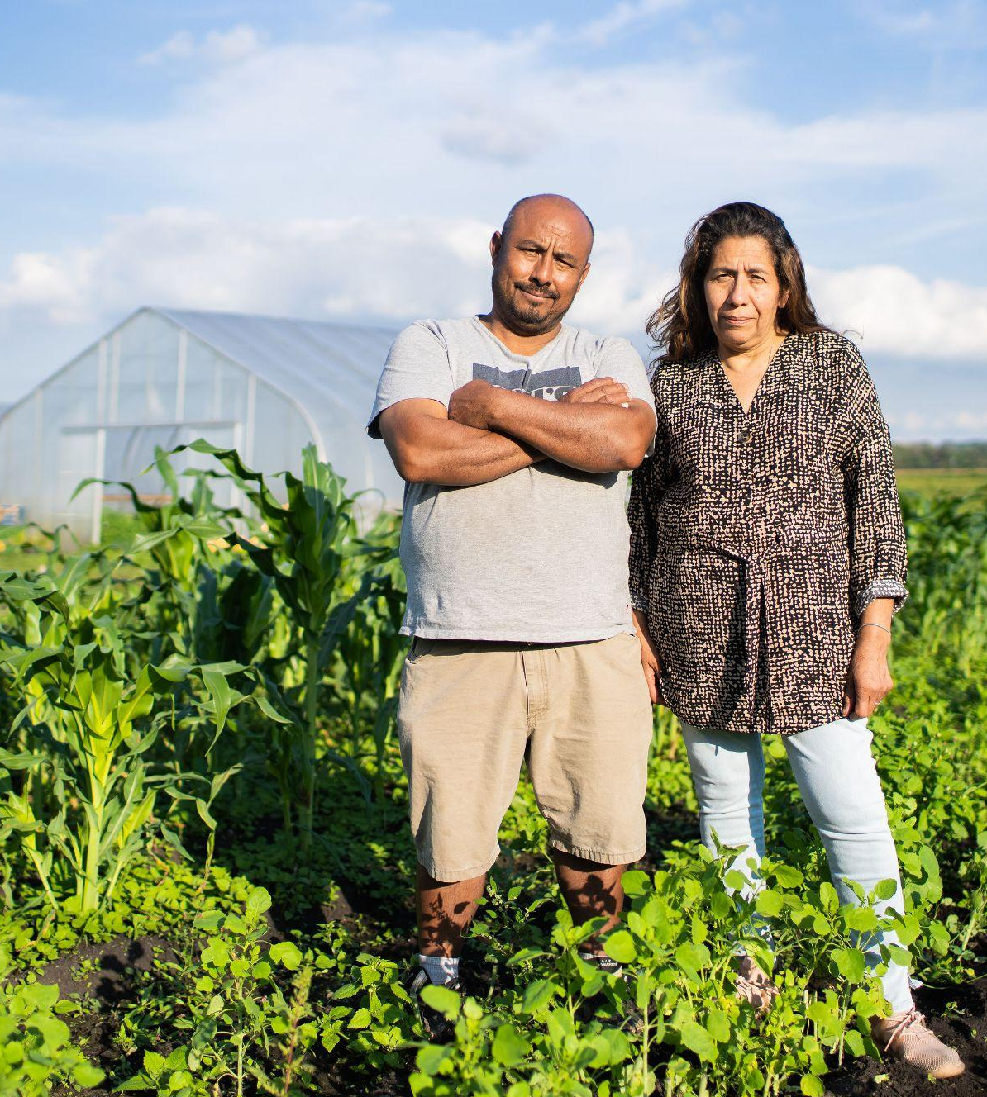
What is Food Sovereignty?
Food sovereignty is the right of peoples to healthy and culturally appropriate food produced through ecologically sound and sustainable methods, and their right to define their own food and agriculture systems. It puts the aspirations and needs of those who produce, distribute and consume food at the heart of food systems and policies rather than the demands of markets and corporations.
– Declaration of Nyéléni, the first global forum on food sovereignty, Mali, 2007
Martín & Gaudencia Rodriguez on their farm, Mimomex. Photo by Jennifer Young. (2022)
NYS Food Summit | June 2024
Notes:
YOU are part of that community.
Raise your hand if you are a farmer? if you get food to people through a food access project? If you like cooking food? If you like eating food? YOU are part of building food sovereignty.

Slide 3
Pre-covid failures of the regional food system
Extremely thin profit margins for small, regenerative farms
Multiple barriers to entry for BIPOC, LGBTQ+ and women
Farms + Production
Unequal distribution in resources, opportunities and outcomes caused by systemic oppression
Lack of coordination and communication
Relies on waste/donation from large agribusiness and corporate food system
Workforce + Infrastructure Development
Hunger relief + food access
Overly centralized distribution system
Relies on volunteer labor
NYS Food Summit | June 2024

Slide 4
Regional food access in the HV:
COVID crisis
Increased market demand for locally produced food
Farms losing wholesale buyers
Farms + Production
Unequal distribution in resources, opportunities and outcomes caused by systemic oppression
Record high unemployment - particularly in food service sector
Inconsistent supply of fresh food / local food for hunger relief
Workforce + Infrastructure Development
Hunger relief + food access
insufficient / broken distribution infrastructure
Exponential increase in food insecurity
NYS Food Summit | June 2024

Slide 5
Premise: Working in community
We need everyone on board to tackle the problem.
Collaboration and communication with a wide variety of people and organizations creates the most enduring and effective work.
Creating an ecosystem, identifying the individual organisms that will do the processes to sustain the ecosystem, will result in a self-sustaining food system modeled on the resilience of natural ecosystems.
Glynwood has expertise in coalition building that can be leveraged to advance the equity of our regional food system.
NYS Food Summit | June 2024

Slide 6
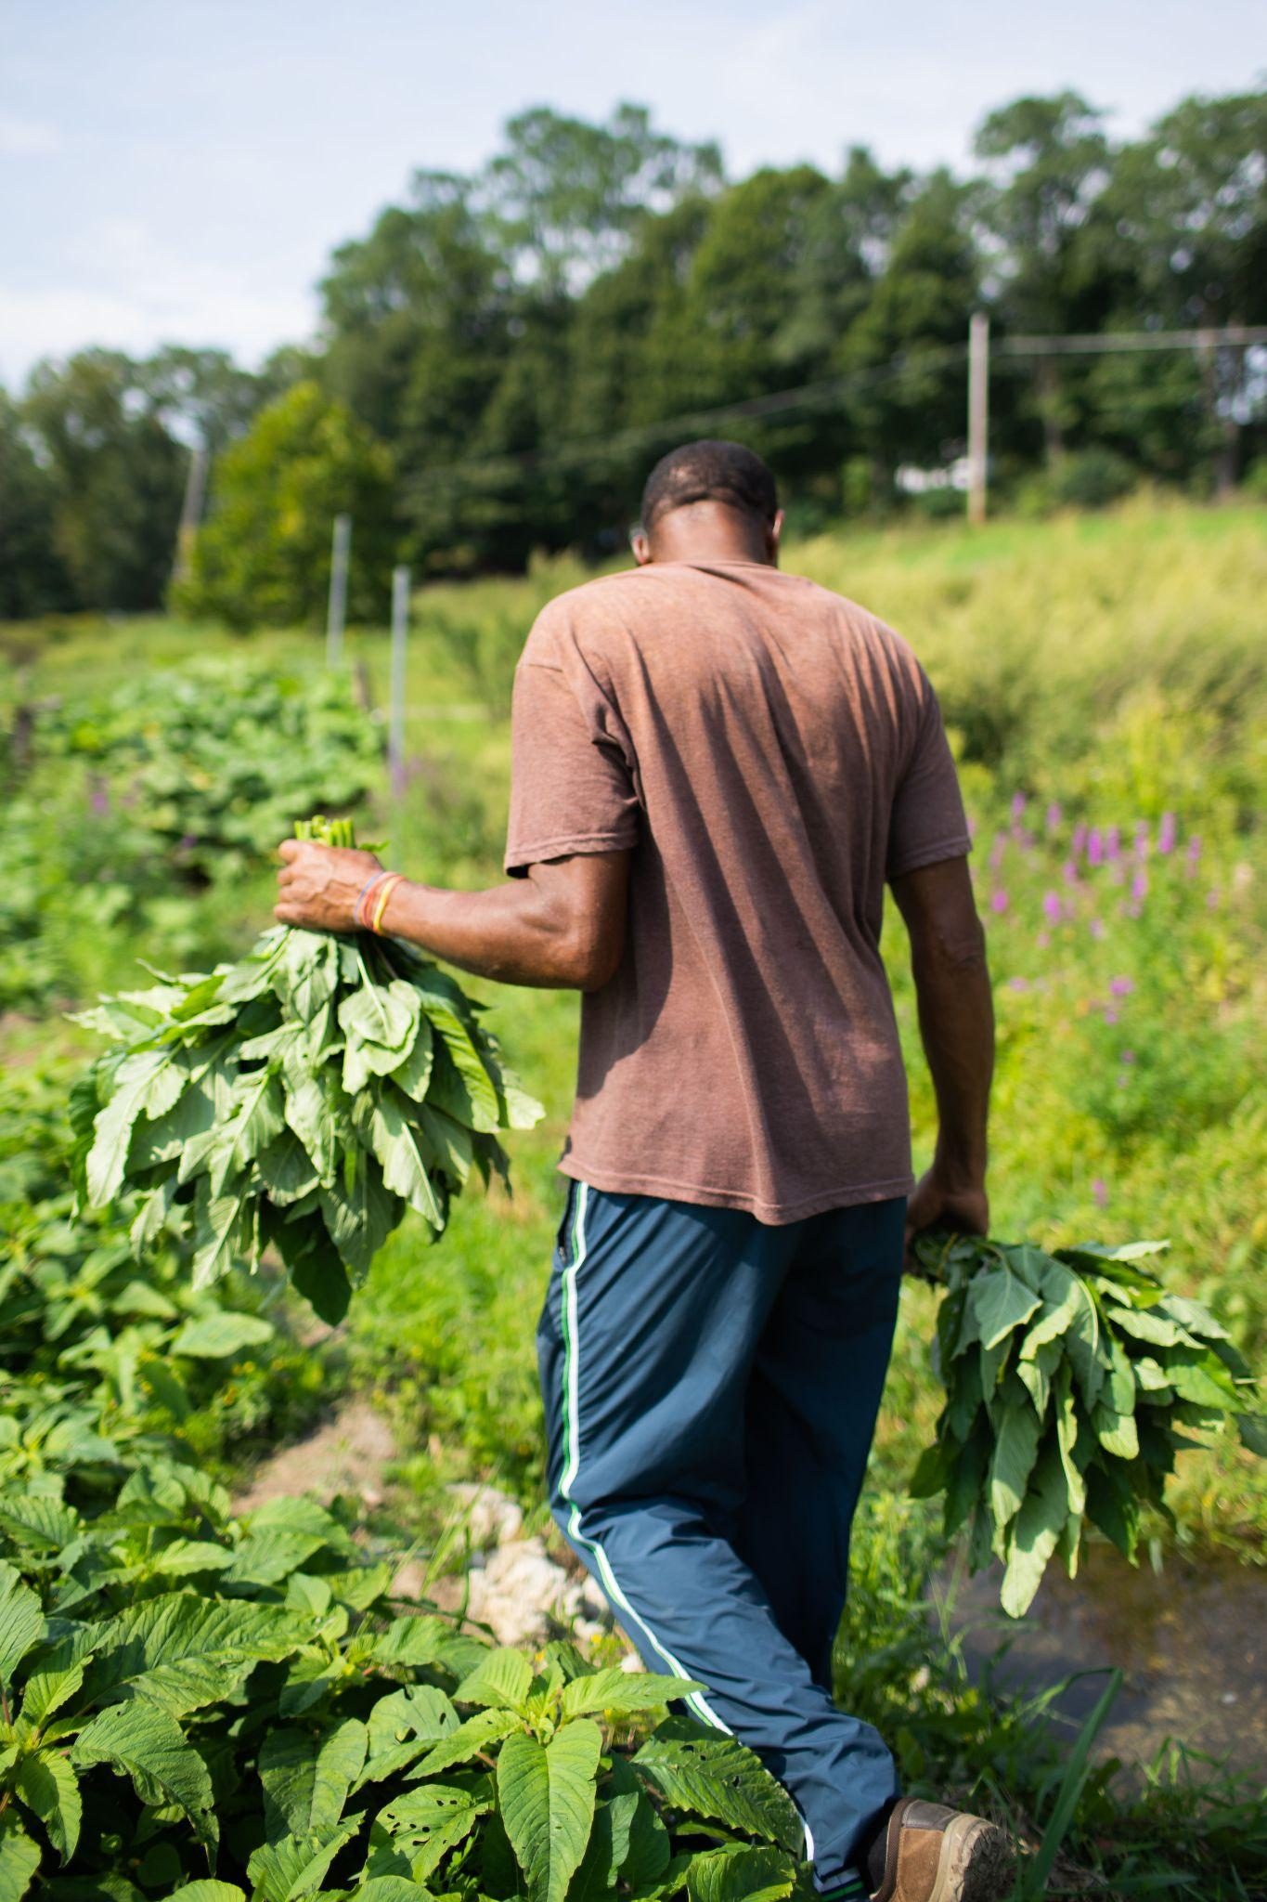
Food Sovereignty Fund Vision
Advance FOOD SOVEREIGNTY in the Hudson Valley
Ensure every Hudson Valley resident, regardless of zip code, can ACCESS farm-fresh, locally-produced food, during and after the COVID-19 pandemic
Fairly COMPENSATE local BIPOC, LGBTQ+, female identifying and beginning farmers for growing food for hunger relief
TRANSFORM the emergency feeding system in the HV by increasing support of and accountability to small-scale farmers, grassroots hunger relief efforts, and the people they feed
Strategically INTEGRATE regional food systems efforts with hunger relief efforts, catalyzed by COVID-19, but mobilized to maintain momentum post-crisis.
Delroy Henningham harvesting Calliloo at his farm, Farm Fresh Caribbean. Photo by Jennifer Young. (2022)
NYS Food Summit | June 2024

Slide 7
Growth of the FSF
2020 | 2021 | 2022 | 2023 | 2024
30+ meetings with farmers and food access workers | 37 farms expressed interest | 17 returning farms 5 new farms | 20 returning farms 2 new farms | 22 returning farms TBD new farms
Formed Accountability Council | Partnered with Epidscopal Charities of New York | Language justice collaboration with HVLJC Built 3 “mini-hubs” (cold storage trailers) | Activation of mini-hubs for aggregation/distribution, external evaluation conducted by CUNY UFPI | Partnered with CCE Putnam, toolkit to be released
10 farms: 3 BIPOC 4 LGBTQ+ 5 women | 17 farms: 15 BIPOC 5 LGBTQ+ 10 women 7 New American | 22 farms: 17 BIPOC 5 LGBTQ+ 16 women 7 New American | 22 farms: 17 BIPOC 5 LGBTQ+ 16 women 8 New American | 22 farms: 17 BIPOC 5 LGBTQ+ 16 women 8 New American
$17,500 of food purchased | $157,000 of food purchased, 53,000 lbs of food distributed through 15 FAPs | $290,000 of food purchased, 89,000 lbs of food distributed through 20 FAPs | $293, 000 of food purchased, 82,000 lbs of food distributed through 21 FAPs | $400,000 of contracts for food purchase to be distributed through 22+ FAPs
NYS Food Summit | June 2024

Slide 8
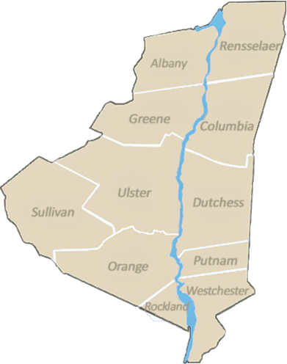
Shared infrastructure
Sub-regional mini-hubs:
local emergency feeding projects
farmers/producers
distribution partners
infrastructure
Currently three mini-hubs in Dutchess and Orange Counties
NECC
Dutchess
Outreach
Our
Core
NYS Food Summit | June 2024
Notes:
A regional network built around local hubs developed with guidance from members of the Accountability Council

Slide 9
Example Timeline
APRIL MAY JUNE JULY AUG SEPT OCT NOV DEC JAN FEB MAR
food delivery and distribution, delivery receipts submitted
AC approves contracts and new farms
Beginning of season partnership planning meeting
Partnership evaluation process begins
Review of evaluations
Review of farm expressions of interest
Contracts conclude, all reporting due
Farms selected to interview for next season
NYS Food Summit | June 2024
Notes:
Raise your hand if

Slide 10
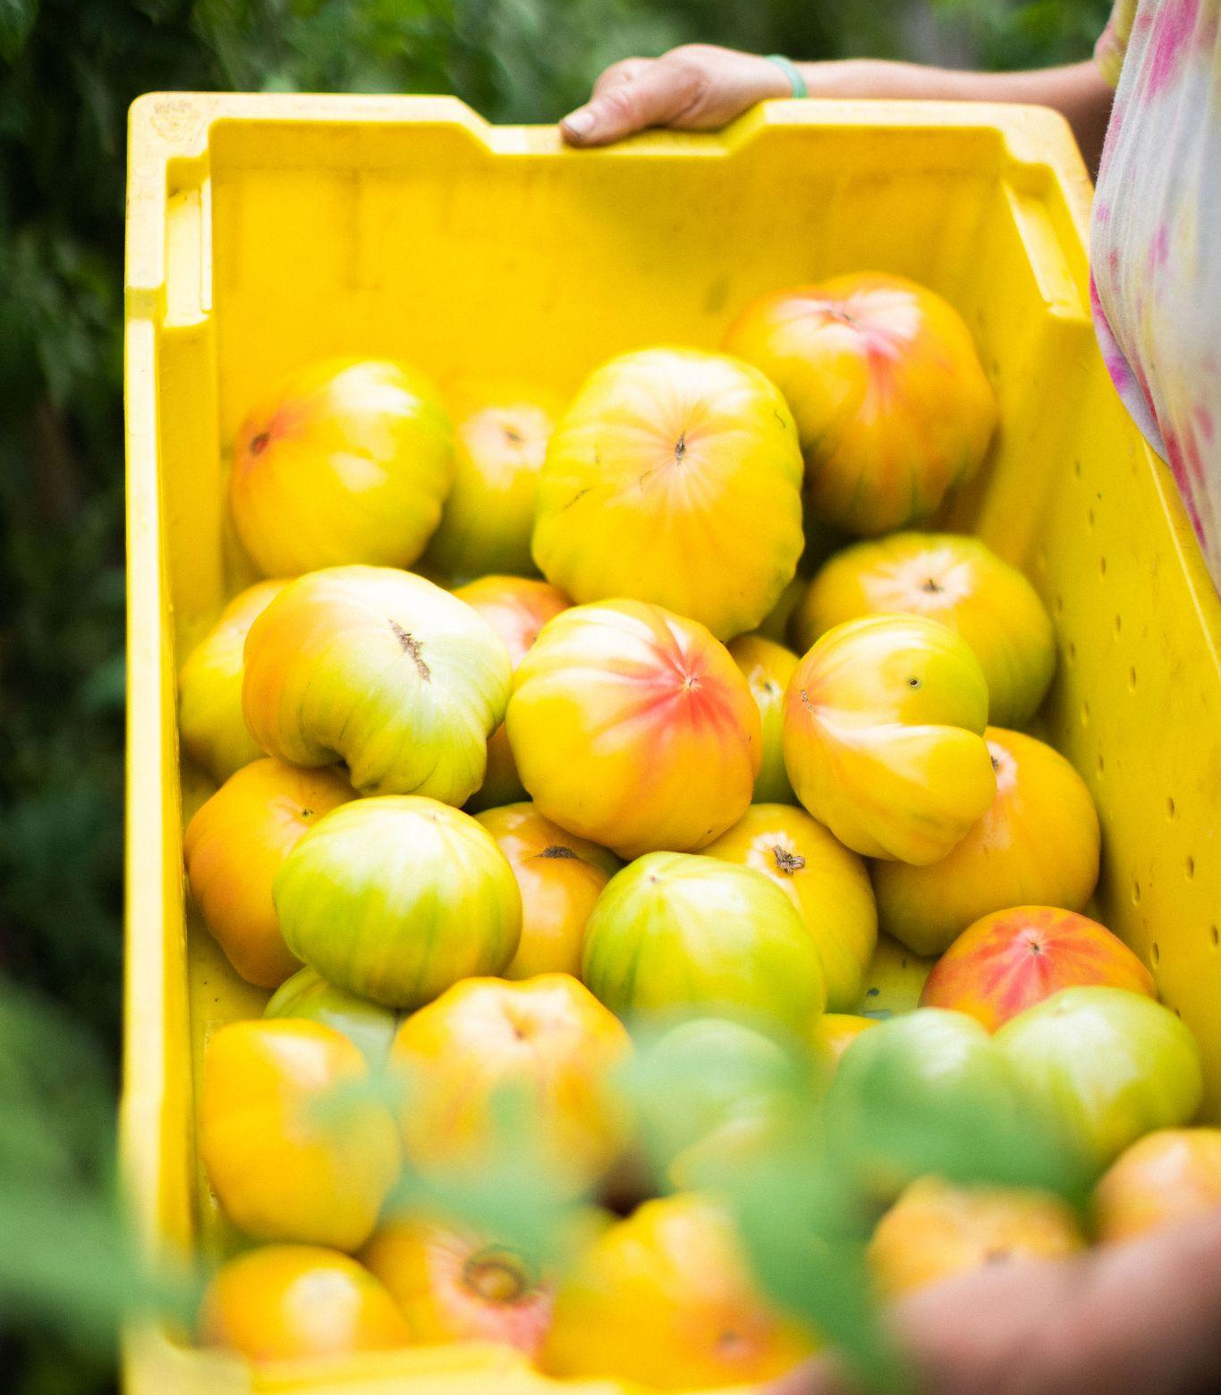
Partnership Management
Each farm/food access project match has a partnership manager
Partnership managers will facilitate pre-season meetings between farmers and food access partners
The farm delivers food and submit delivery receipts to the food access partner and the partnership manager
Everyone participates in an end of year self- and partner- evaluations
NYS Food Summit | June 2024
Notes:
Raise your hand if

Slide 11
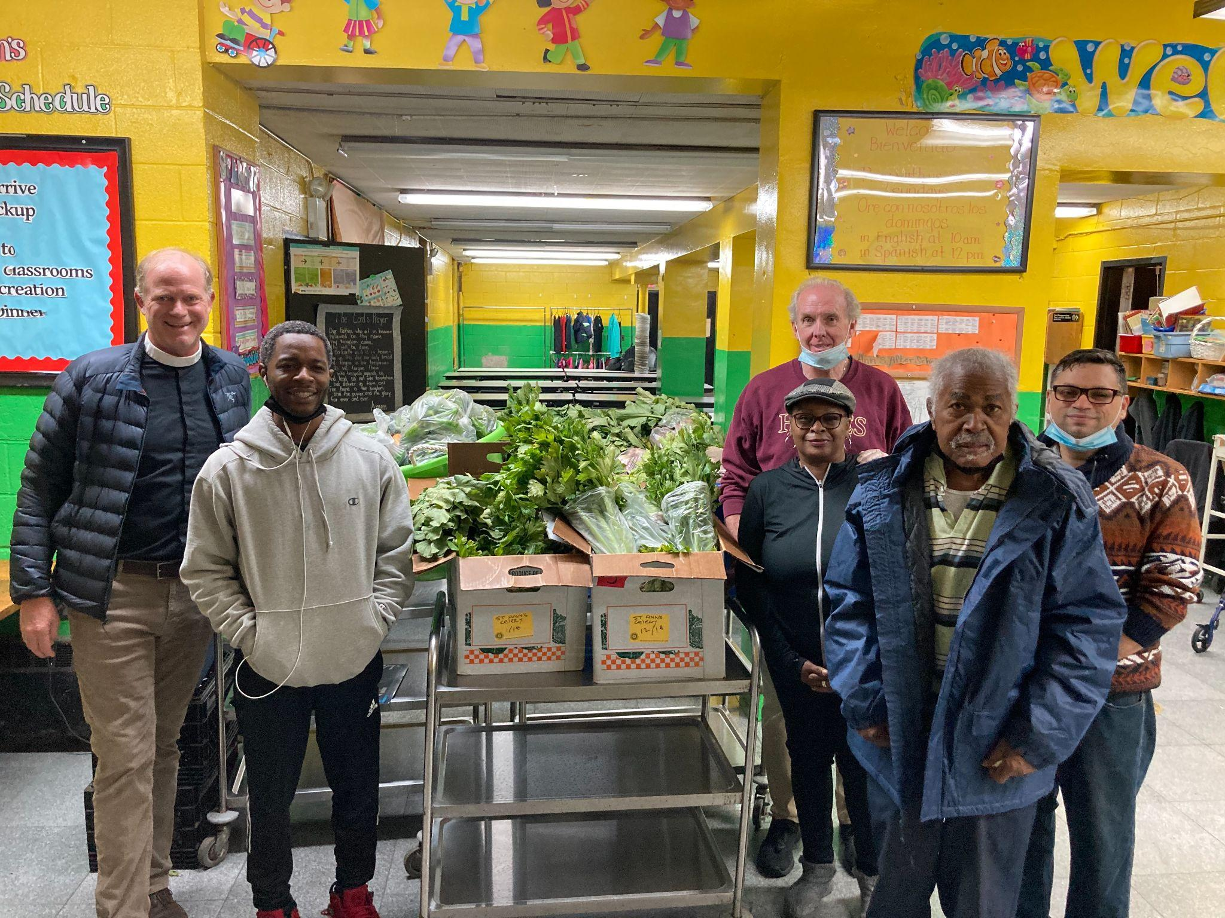
Martín
Implementation Guide
Program Implementation
Forming an Accountability Council
Setting Program Criteria & Objectives
Establishing a Program Budget
Farm Selection & Contracts
Establishing Relationships
Reporting Recommendations
Program Evaluation
Providing Technical Assistance
Cultivating a Community of Practice
Language Justice Practices
Removing Barriers to Participation
Sustaining The Work
Fundraising Recommendations
Policy Recommendations
Partnership Recommendations
Addressing Constraints
Appendix
Customizable templates for MOUs, SOPs, reporting, project management, and evaluation
Father Matthew Engleby (L) with volunteers at St. Ann’s Episcopal Church’s Food Pantry. Photo by. (2022)
Notes:
Raise your hand if

Slide 12
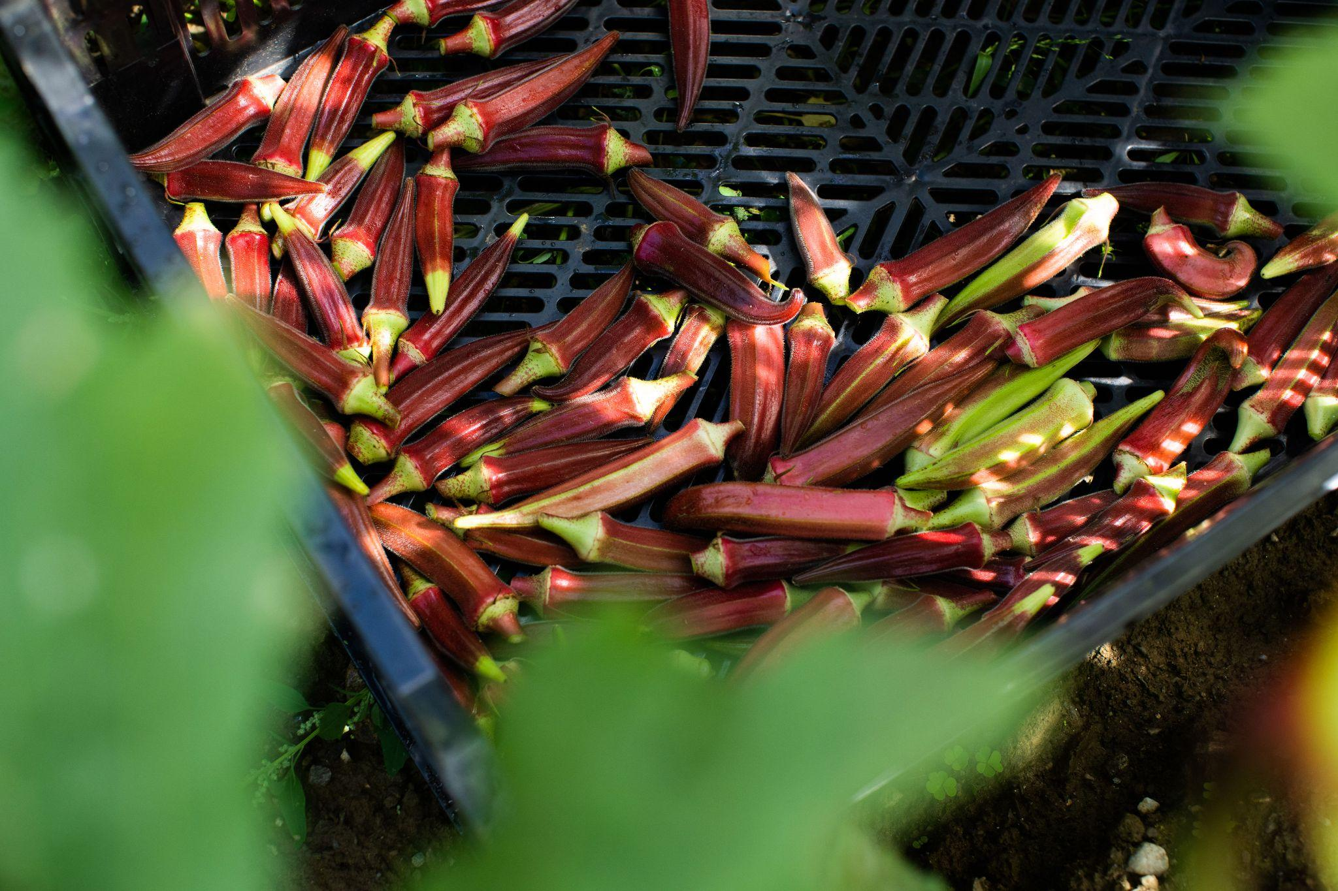
Megan Larmer
Glynwood
Michelle Hughes
Glynwood
Stiles Najac
Cornell Cooperative Extension Orange County
Sarah Salem
Hudson Valley
Food Systems Coalition
Maggie Cheney
Rock Steady Farm
Jordan Schmidt
Northeast Community Center
Discussion

