Slide 1
STRENGTHENING THE SAFETY NET
THROUGH RELATIONSHIPS
NYS FOOD SUMMIT
Notes:
J. Intro and brief scope of FFFA work
B. intro

Slide 2
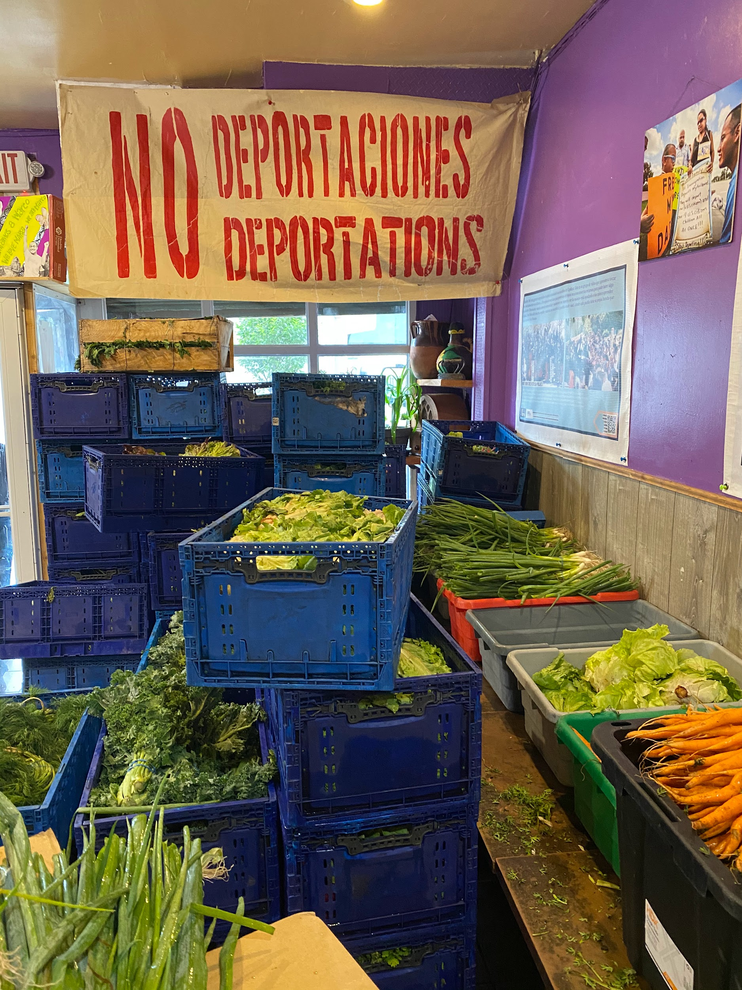
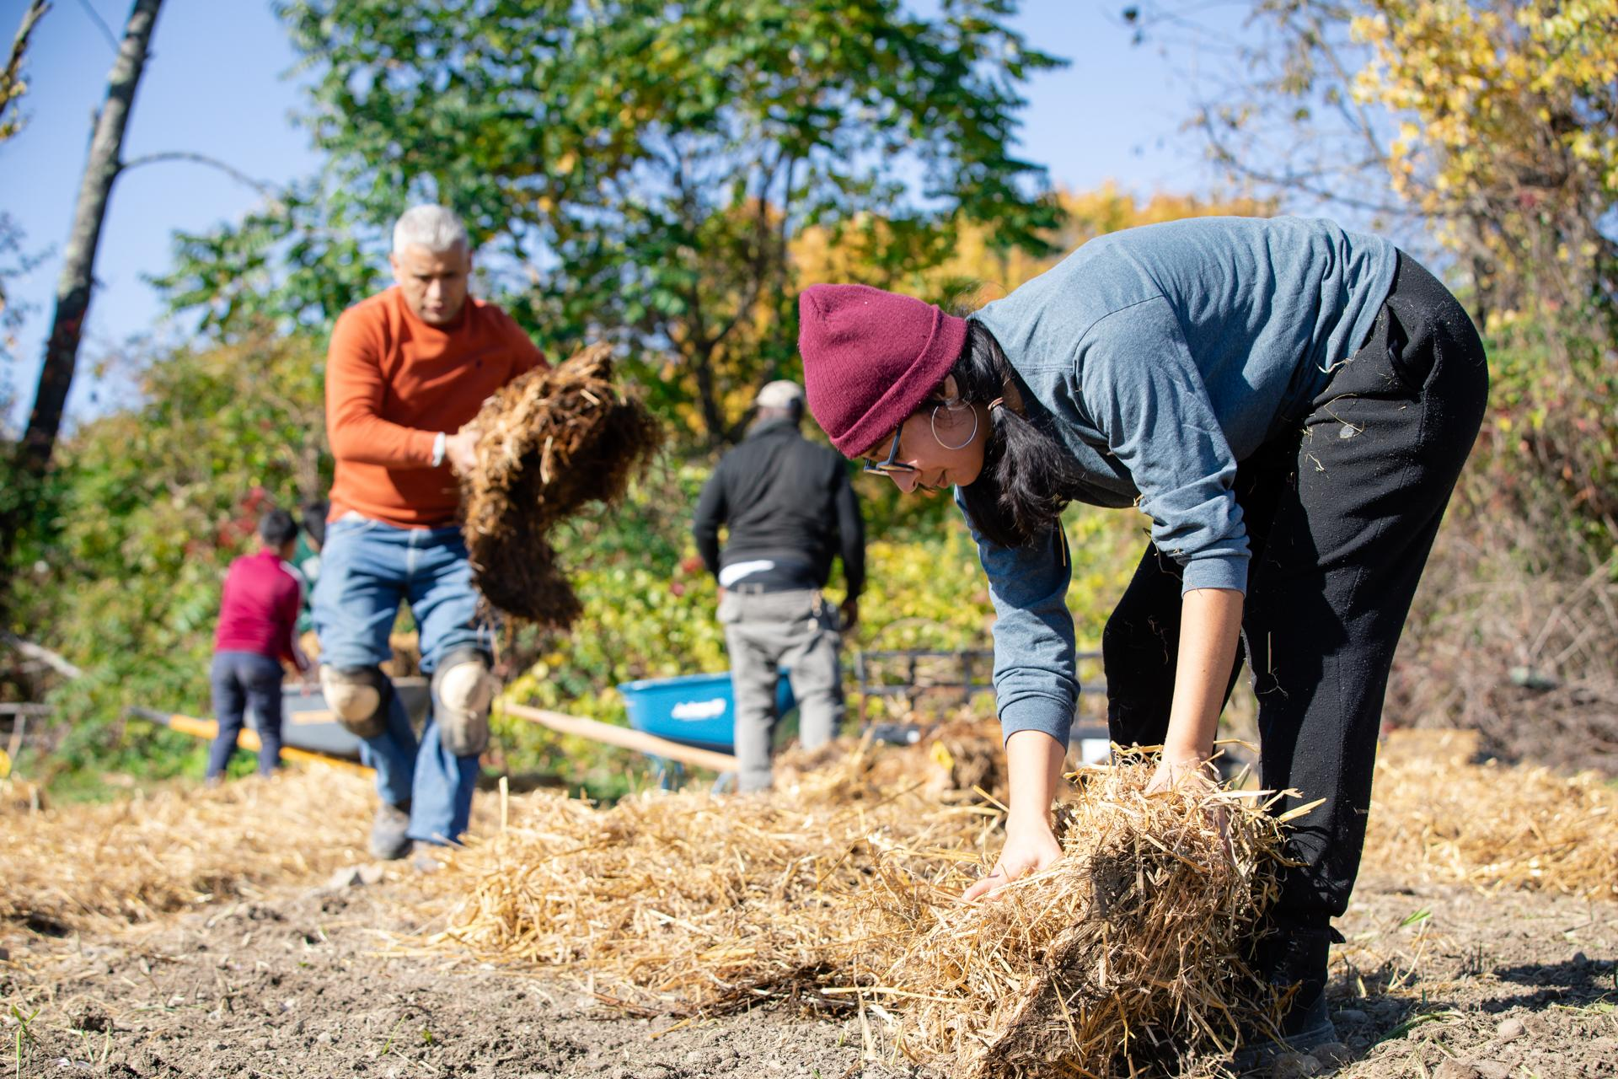
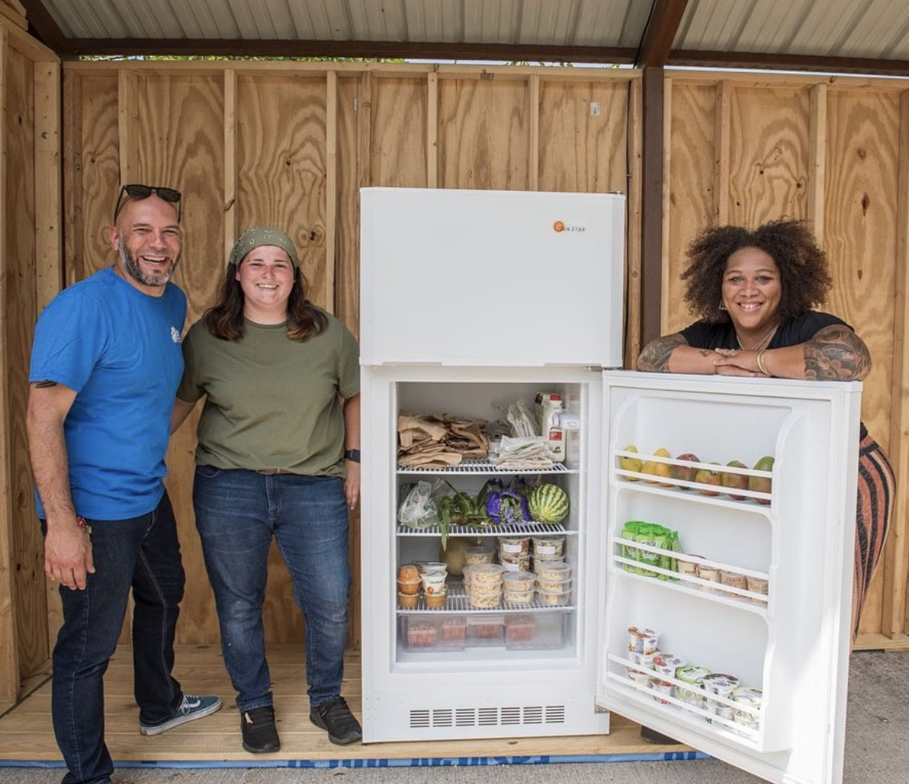
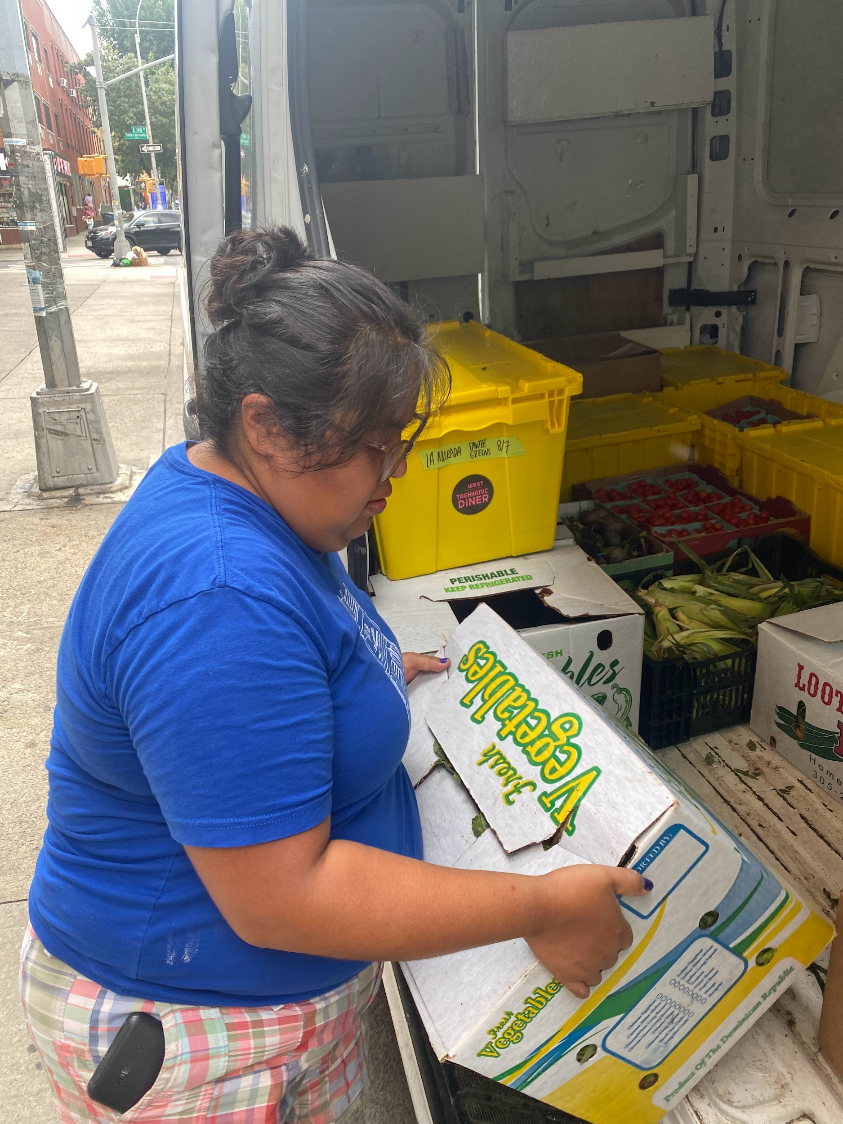
Notes:
B. slide about who we serve, not included in the safety net- SPECIFIC WHO- my story
J. speaks to BIPOC left out of safety net or worse not dignified
***POINT OF this SLIDE is that we SERVE those that fall through the “Safety Net” of government and other programs

Slide 3
Notes:
B. speaks to 2024 MoU’s with QTBIPoc Farms ($15k, spend down model) and Nourish NY, Procurement as a vehicle for dismantling racism in the food systems….you’ll learn more from the experts later today.
J. speaks to

Slide 4
ASK
Listen
Non Competitive Funding
COMMUNITY BASED SOLUTION
LEARN SHARE
Notes:
HOW WE BUILD SOLIDARITY/ the strong foundation our communities need
Connected communities
A culture of shared ownership, mutual aid, and belonging
Patterns and practices of reparative redistribution of resources that builds a sustainable equitable system
A community invested in the success of ourselves, our families, our children, our neighbors
Mutual aid embedded into organization and company work culture
A Strong local mutual aid network and with trusted, reliable community resource/food access points

Slide 5
PROGRESSIVE
STACK
PUSH
STEER
Notes:
What is the dominant narrative you’re challenging with your idea? What is the counter-narrative you’re trying to make a reality?
This whole project is about changing the dominant narrative
Dominant narrative: Capitalism and white supremacy set up a market based food system that doesn’t feed everyone, and throws 30% to 40% of our country’s food supply to landfills… this isn’t working for our communities and we deserve more, we can build access to more
The counter narrative: food is a human right! It is inhumane to treat food as a commodity, so we are sharing and and in the process building trust and love in our community…and building a food system that actually works – and if we can create equity in food, we can translate that model of organizing to change other narratives
Destigmatize Food Insecurity and Poverty
Reject the means-testing and policing of resources
Embrace a mutual aid culture that redistributes resources according to human need.
Drive the culture shift from individualism to community solidarity

