Slide 1
Home Delivery: Why It Matters
Dr. Cynthia Bott, LCSW and
Sarah Toledano, LMSW
Notes:
CB does intro

Slide 2
We lost our home due to foreclosure. We were facing eviction and short on money. At the end of the month nothing was left.
My husband passed and I lost the income he had. I am working but can't even cover the mortgage, I will be homeless with 2 dogs if someone can't help.
I can't get away - I am babysitting my granddaughter M-F. By the end of the day, my feet and legs are swollen.
I have a master's degree, it is embarrassing, I had an awesome job, but faced horrible health issues and got fired.
Notes:
We lost our home due to foreclosure. We were facing eviction and short on money. At the end of the month nothing was left.
I have a master's degree, it is embarrassing, I had an awesome job, but faced horrible health issues and got fired.
My husband passed and I lost the income he had. I am working but can't even cover the mortgage, I will be homeless with 2 dogs if someone can't help.
I can't get away - I am babysitting my granddaughter M-F. By the end of the day, my feet and legs are swollen.
CB starts and Sarah does last Quotation

Slide 3
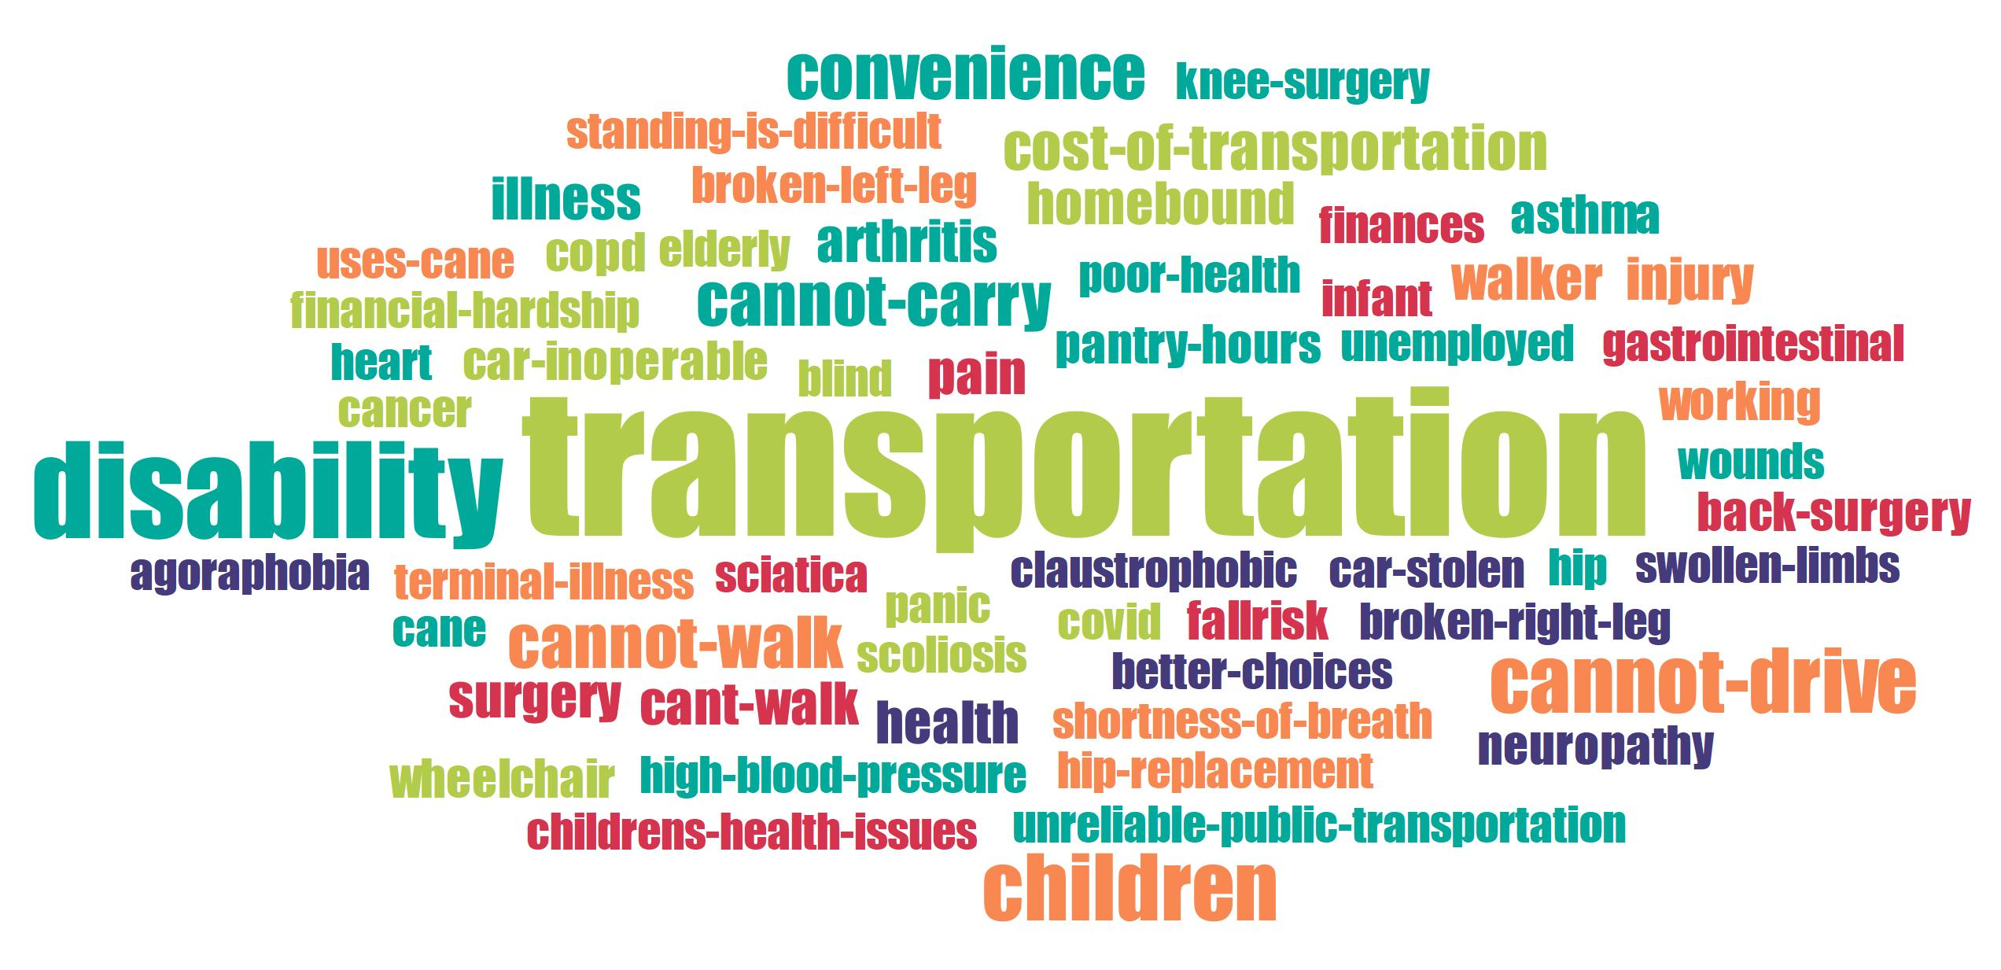
WHY HD
Notes:
Hi we are Sarah and Cindy. Here to present the first part of a consumer study of people with home delivery. With a team of volunteers, we conducted over two hundred phone interviews with folks receiving home delivery from the following counties: Renessalaer, Schenectady, Saratoga, and Albany. During this talk we will showcase our findings and some anonymous quotations from folks that we spoke with. We are especially interested in how this studies population differs from the general population.
CB does this slide
Sarah there are four reasons folks use home delivery that came to the top

Slide 4
Transportation
I don't have a car, 8 or 9 months ago the transmission died and its 4,000 to fix

Slide 5
Disability
I’m disabled, can't carry bags, no one to help me

Slide 6
Getting Around
I'm homebound - I cannot walk more than 10 steps, I’m in pain, I use a walker

Slide 7
Childcare
I have two young kids and it makes it hard to go someplace

Slide 8
Youngest – 21
Oldest – 80
Average – 46
43% - 55 and older
Median – 45.5 (per US Census 38.5)
Notes:
How does HD population differ
My health does not allow me to carry - shoulder, knees, joint pain. I've slowed down some due to age
CB does this slide

Slide 9
US Census – 50.4% of the population is female
Notes:
How does our population differ – use the stats slides here, anecdotally many mothers report losing benefits because of receiving aid
Gender - I feel bad - I started working, between my income and son's SSI I don't qualify for SNAP but still struggling - you get something good but it ends up hurting you
Sarah does this slide

Slide 10
National Center for Education Statistics 2020 National – 87%
NY State – 84%
Notes:
How does HD population differ – use the stats slides here
CB does this slide and CB will find something to say here

Slide 11
Pew Research Center – 2023, approximately 13% of population
Notes:
How does HD population differ – use the stats slides here
Disability - I don't drive and I can't walk all the way there because of knee and back problems, I can't carry stuff
Disproportionate amount of home Delivery population are receiving state or federal disability.
Sarah does this one

Slide 12
USDA Economic Research Service
2022 – 5.1% of US households with very low food security; 7.7% with low food security.
Notes:
How does HD population differ – use the stats slides here
food insecurity - food wasn't lasting, food is expensive, I can't eat like I used to because of diabetes; I didn't have enough to eat, especially the vegetables, meats are expensive, food stamps are not enough
This tells us that you are serving the population you are meant to be serving.
CB does this one

Slide 13
Income
8 respondents reported no income
46 preferred to not answer
Median US per Census: 6,215
HD Respondents: 1,300
Notes:
Income: I wasn't getting food stamps, my husband was not working and disabled, we have one income
This shows how precarious income is for folks and that disability income does not go very far at all.
Sarah does this slide

Slide 14
Take Away – Sharing is Caring
I'm grateful for what I get and I shouldn't complain, whatever I don't use, I share with others.
I always share what I don’t eat.
I get to make nice salads and share with grandchildren for the health benefits.
Notes:
SHARING – nothing is wasted
CB does this slide

Slide 15
Take Away – Immense Gratitude
I think they are fantastic and I am grateful to them. They are all wonderful, I wouldn't eat without them.
The Thanksgiving basket was fantastic, one time we got honey glazed carrots - they were delicious.
I am so grateful to those people who volunteer there. They take a huge burden off me as a single mother.
Notes:
THANKS – so much gratitude
(1) I think they are fantastic and I am grateful to them. They are all wonderful, I wouldn't eat without them
(2) The thanksgiving basket was fantastic, one time we got honey glazed carrots - they were delicious
(3) I am so grateful to those people who volunteer there. They take a huge burden off me as a single mother.
Sarah does this slide

Slide 16
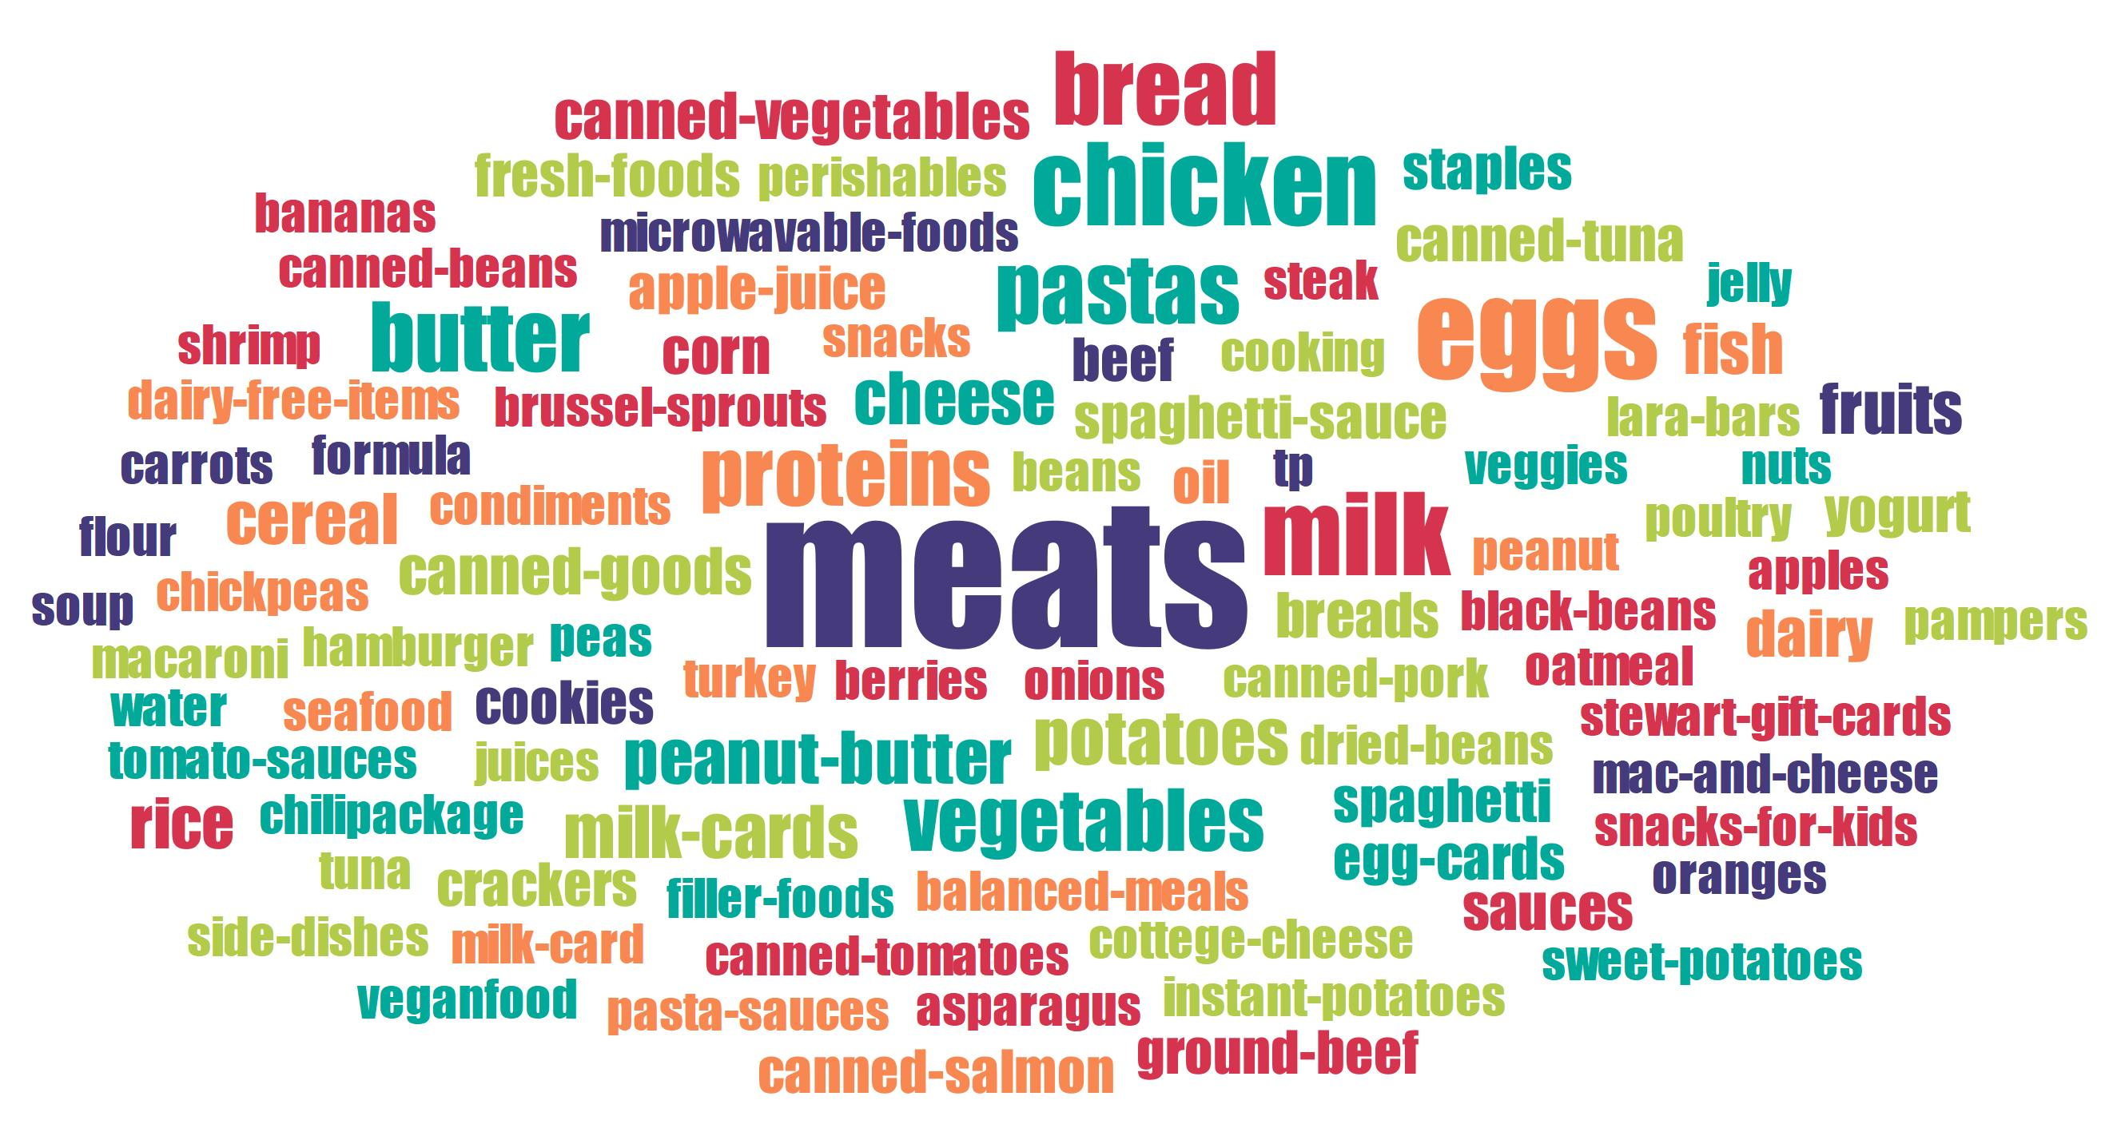
Notes:
LEAVE YOU WITH THIS SLIDE ABOUT WHAT PEOPLE RELY ON from the pantries
CB does this slide and closes out

