Slide 1


Nutrition and NY's Section 1115 Waiver
A Beginner's Workshop
Katie Garfield, JD
Director, Whole Person Care
Center for Health Law and Policy Innovation
Harvard Law School

Slide 2
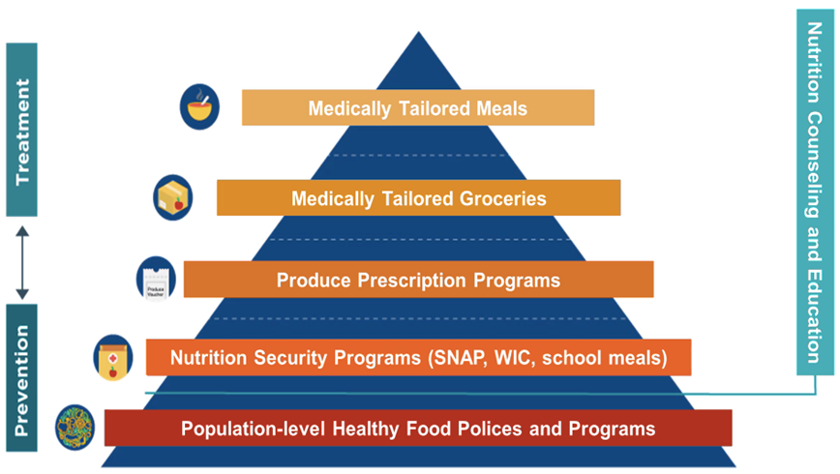
Food is Medicine Defined
Food is Medicine (FIM) interventions are tailored to respond to the connection between food and health by helping to prevent and treat diet-related disease
Two components:
The provision of food that supports health, such as medically tailored meals or groceries, or food assistance, such as vouchers for produce
A nexus to the health care system
Aspen Institute and Center for Health Law and Policy Innovation,
Food is Medicine Research Action Plan (Jan. 2022)
Dariush Mozaffarian et al., A Food is Medicine approach to achieve nutrition security and improve health, 28 Nature Medicine 2238 (Nov. 2022), https://doi.org/10.1038/s41591-022-02027-3.

Slide 3
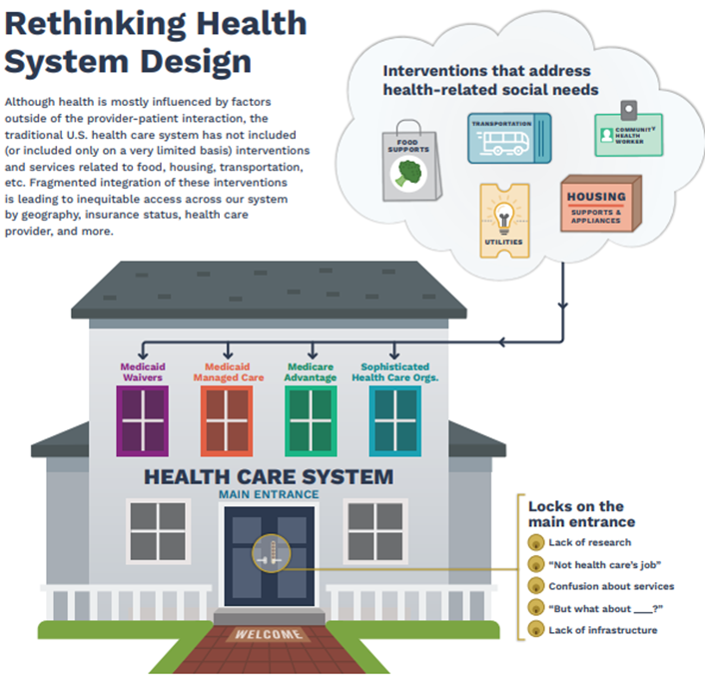
Policy Pathways
No current coverage of Food is Medicine services (direct provision of food) – beyond limited circumstances – in baseline Medicaid coverage or
Original Medicare under federal law
Must utilize legal and regulatory flexibilities such as
state waivers in Medicaid and supplemental benefits in Medicare Advantage

Slide 4
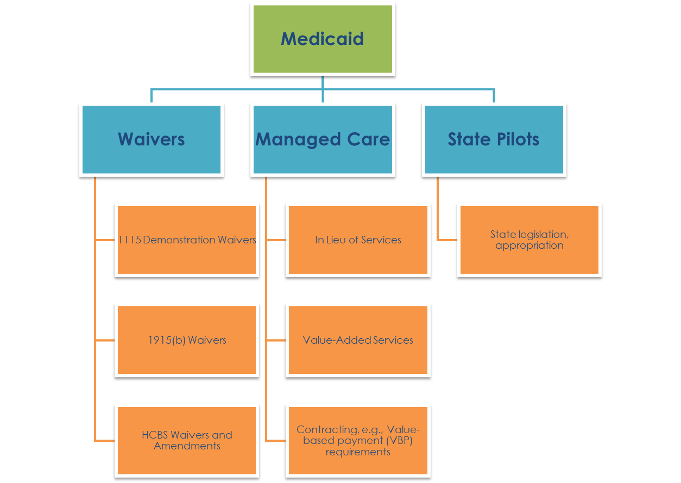

Slide 5
What Are Section 1115 Waivers?
With CMS approval, states can implement experimental, pilot, or demonstration projects
Can cover services and populations not included under federal law
Requirements:
  Must promote the objectives of the Medicaid program
  Must be budget neutral (but flexibility for certain HRSN services)
  Initial 5-year approvals, can be renewed for 3–5-year periods
  States must contract with independent evaluators to conduct periodic evaluations and provide CMS with reports on the waiver’s outcomes
Examples:
  Mandate enrollment in managed care
  Cover nontraditional services to address health-related social needs (HRSN)

Slide 6
HRSN-Specific 1115 Waivers
Requirements | Services Allowed | Patients Reached
Budget neutrality flexibility for HRSN HRSN costs limited to 3% of annual Medicaid spend Infrastructure funding available, limited to 15% of HRSN spending | 10 Housing Services 5 Nutrition Services Other Services w/ CMS Approval | Can be statewide HRSN services must be medically appropriate under state-determined clinical and social risk factors Example populations targeted: Chronic diet-related conditions Pregnant/post-partum SMI/SUD Above health conditions w/ Risk of/homelessness Food insecurity Recently released from incarceration

Slide 7
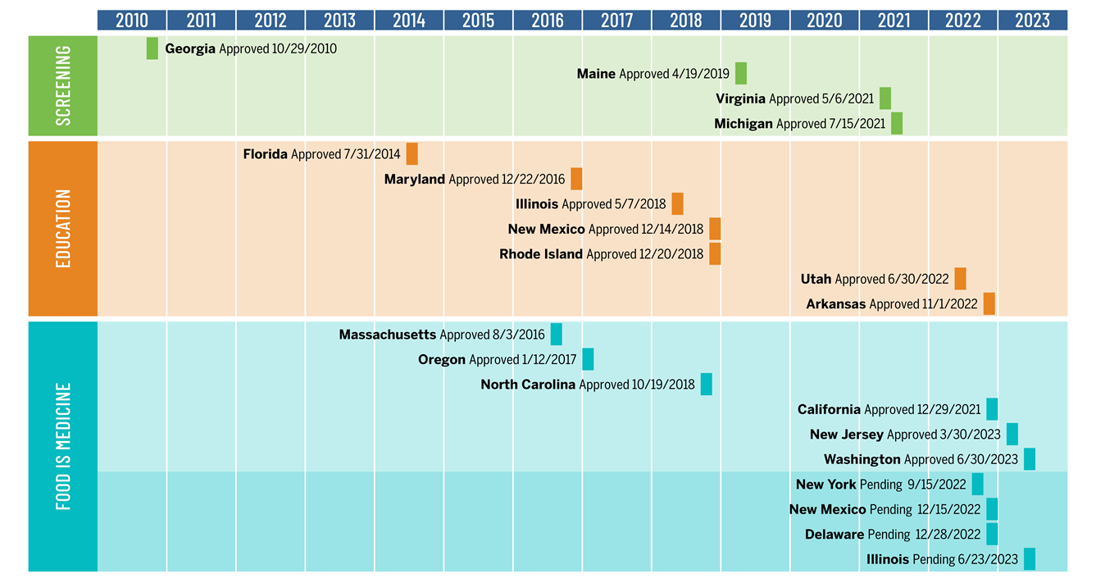
1115 Waivers: Nutrition Trends
SOURCE: Erika Hanson et al., The Evolution and Scope of Medicaid Section 1115 Demonstrations to Address Nutrition: A U.S. Survey, Health Affairs Scholar, qxae013, https://doi.org/10.1093/haschl/qxae013

Slide 8
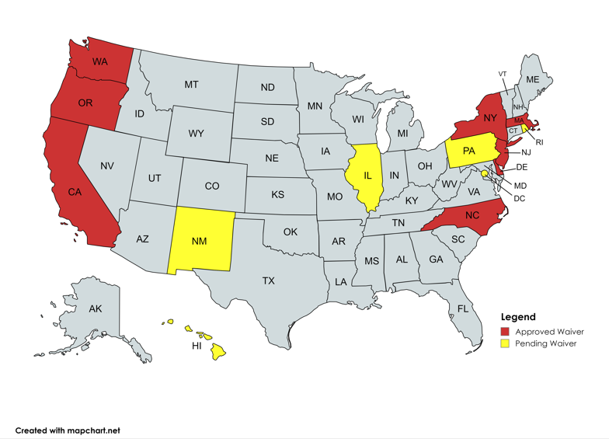
1115 Waivers: Direct Provision of Food

Slide 9
New York's 1115 Waiver Amendment
CMS approved amendment on January 9, 2024
  New York’s Section 1115 “Medicaid Redesign Team” (MRT) Waiver: operated since 1997, extended several times
  Several initiatives: (1) HRSN, (2) HERO, (3) Medicaid Hospital Global Budget Initiative, and (4) Strengthen the Workforce
  Key components: (1) services, (2) target populations, (3) implementation, (4) monitoring and evaluation
Opportunities for Engagement
  Engage in Health Equity Regional Organization (HERO), Social Care Networks (SCNs), evaluations
  Engage decisionmakers (DOH) and stakeholders (providers, plans, community members)
  Educate providers
  Activate coalitions
  Engage Medicaid partnerships
  Continue to build infrastructure

Slide 10
Waiver Services: Nutrition Supports
Intervention | Description
Nutrition counseling and education | Including on healthy meal preparation and connecting the individual with grocery budget resources
Prepared meals approved by a Registered Dietitian Nutritionist (RDN) | Up to 3 meals per day, delivered to the home or private residence, for up to 6 months
Medically tailored or nutritionally-appropriate food prescriptions | E.g., fruit and vegetable prescriptions, protein box, delivered in various forms such as nutrition vouchers and food boxes, for up to 6 months
Fresh produce and nonperishable groceries | Limited to pregnant persons and children
Cooking supplies | That are necessary for meal preparation and nutritional welfare of a beneficiary when not available through other programs (e.g., pots and pans, utensils, microwave, refrigerator).
Private and public transportation | To transport members to covered HRSN services and case management activities

Slide 11
Waiver Services: Nutrition Supports
Beneficiaries cannot receive more than one direct food support
    E.g., a beneficiary who receives a food prescription cannot also receive meals
Additional nutritional support for the household of high-risk pregnant individuals or high-risk children is permitted
    Household size is defined in line with the state’s SNAP household definition
Nutritional interventions may be renewed for additional 6-month periods if the state determines the beneficiary still meets the clinical and needs-based criteria
Individuals with high-risk pregnancies can receive nutrition interventions for up to the length of the pregnancy and up to two months postpartum, for a total of 11 months

Slide 12
Target Populations
Level 1 services: referral to existing state, federal, and local programs and case management
  All Medicaid beneficiaries
Level 2 services
  Enrolled in Medicaid managed care, AND
  Meet certain criteria, as defined in in the post-approval Protocol(s) for HRSN Services and Infrastructure, subject to CMS review and approval, MAY include:
    (1) Medicaid high utilizers, (2) Individuals enrolled in a New York state designated Health Home, (3) Individuals with SUD, (4) Individuals with serious mental illness, (5) Individuals with intellectual and developmental disabilities, (6) Individuals who meet the HUD definition of homeless, (7) Pregnant persons, up to 12 months postpartum, (8) Post-release criminal justice-involved population with serious chronic conditions, SUD, or chronic Hepatitis-C, (9) Juvenile justice involved youth, foster care youth, and those under kinship care (10), Children under the age of 6, (11) Children under the age of 18 with one or more chronic conditions

Slide 13
Implementation
Includes up to $500 million in infrastructure funding to support availability and quality of HRSN services
The state will contract with a single, statewide, independent Health Regional Organization (HERO) that will conduct:
    Data aggregation, analytics, and reporting
    Regional needs assessment and planning
    Regional stakeholder engagement sessions
    Value-based payment design
    Program analysis
The state will award one Social Care Network (SCN) per region (up to five in New York City) to be a designated Medicaid provider and lead entity for CBOs providing HRSN services, and provide HRSN screening and referral services
The state will set HRSN service rates
The state must submit its Implementation Plan for CMS approval by October 9, 2024

Slide 14
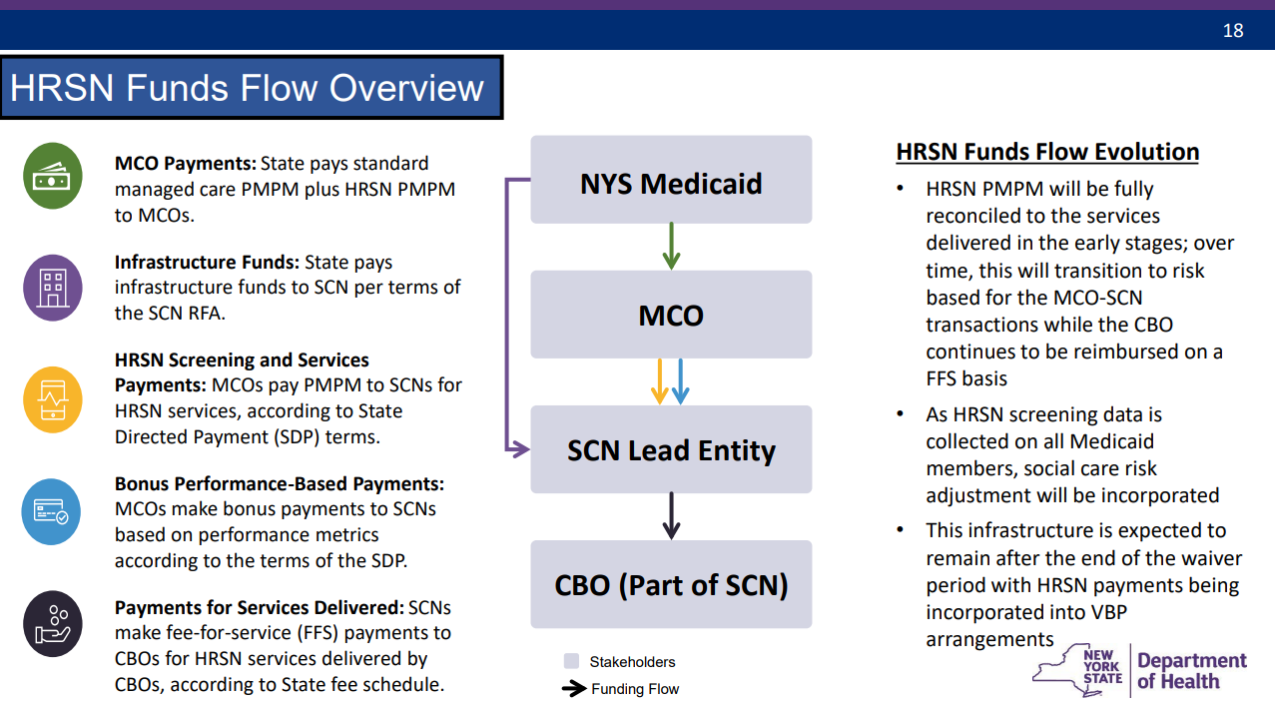

Slide 15
Monitoring and Evaluation
Section 1115 demonstrations require an independent evaluator
The state must track and report on:
  Beneficiary HRSN data
  Information technology infrastructure to support data
  Percent of Medicaid beneficiaries enrolled in other public benefit programs (e.g., SNAP or WIC)

Slide 16
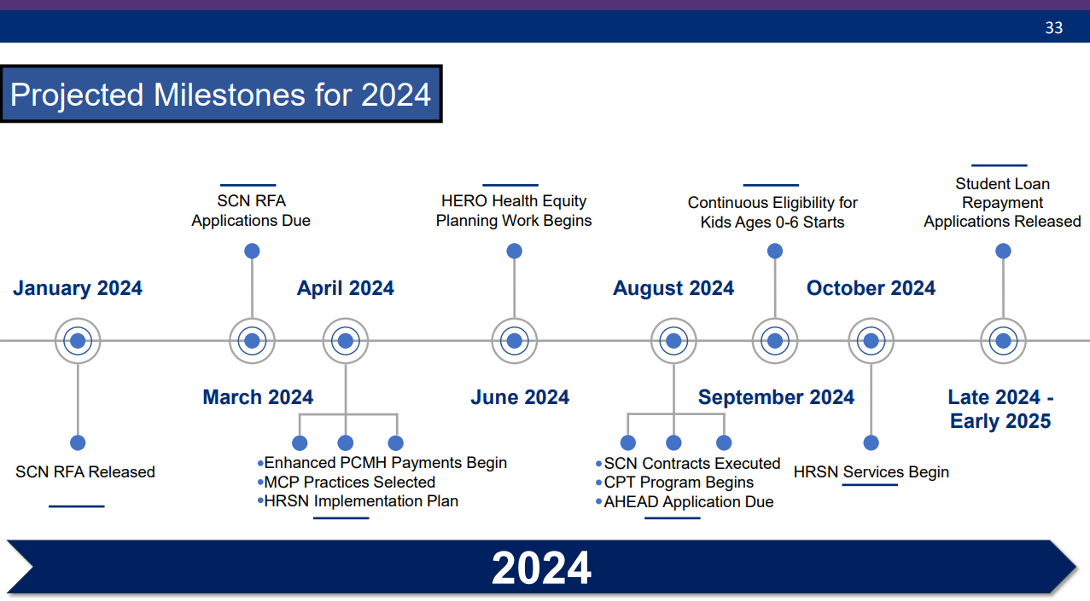

Slide 17
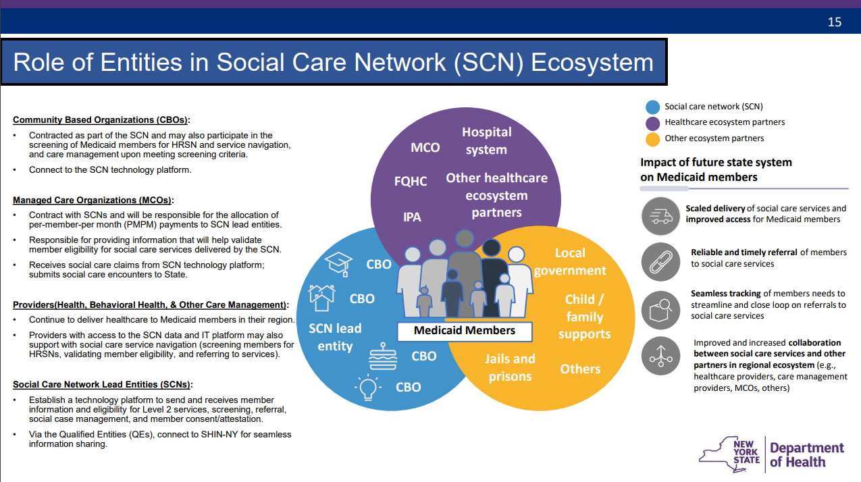

Slide 18
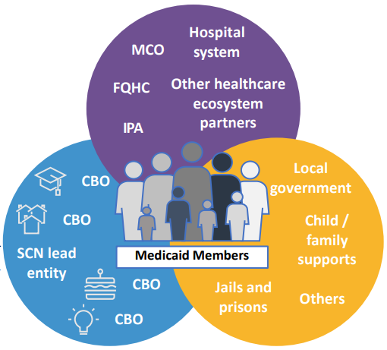
Table Discussions
Do you plan to participate in the waiver?
  If not, why not?
What role could you play?
  What services could you provide?
What partners could you engage?
What resources/supports do you need to participate?
What challenges do you foresee?
What questions/concerns do you have?

